Slide 1
COSC INTERNSHIP DRIVE VEHICLE REGISTRATION FOR CBIT PARKING
TEAM - 1

Slide 2
TEAM MEMBER’s
G. Pavan Praneeth – CSE - 3rd Year – Mobile App Development
Sowmya Bommu – CSE – 3rd Year – Mobile App Development
Mohammed Abdul Mateen – IT – 2nd Year – Database
Mohammed Adnan – CSE – 1st Year – API
Rohit Kumar Bandaru – CSE – 2nd Year - Web Development
Kalyan Reddy Gone – IT – 2nd Year – Web Development
Ganga. Bhanu Teja – CSE – 1st Year – Web Development
Koppala Praneetha – CSE – 1st Year – Web Development

Slide 3
PROBLEM STATEMENT
There will be two parts :
User :
Student sign-up/login.
Home screen with registered vehicles and driving licence.
Add vehicle option with all the details of the vehicle in RC.
Delete vehicle option.(Can be added back by paying fine)
Limit vehicles (2 per person only)
Apply for new CBIT parking sticker for particular-vehicle (fine payment using request id)
Admin :
Admin login.
Receive applications for vehicle registration, Verify and Approve.
Receive fine payments physically, update payment status and issue parking stickers.
Dismiss any vehicles registration (in case of misbehaviour).
Statistics page.

Slide 4
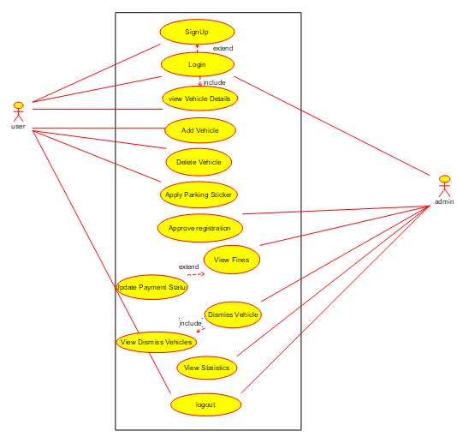
UML DIAGRAM

Slide 5
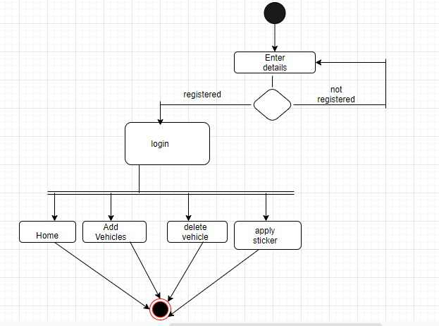
ACTIVITY DIAGRAM
Mobile app activity diagram

Slide 6
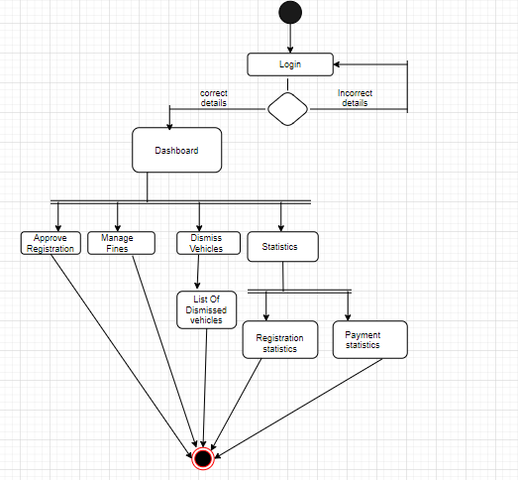
ACTIVITY DIAGRAM
Web application activity diagram

Slide 7
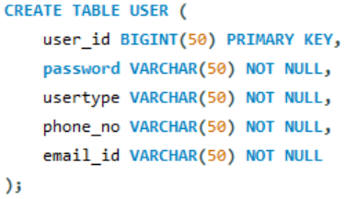
DATABASE
Database was created using AWS MySQL. Which have 3 tables :
This table will be holding all the credentials of the user’s and admins.
Every user id will be unique.
This data comes in handy when an admin/user tries to login, if that credentials are authentic then they will be redirected to dashboard.

Slide 8
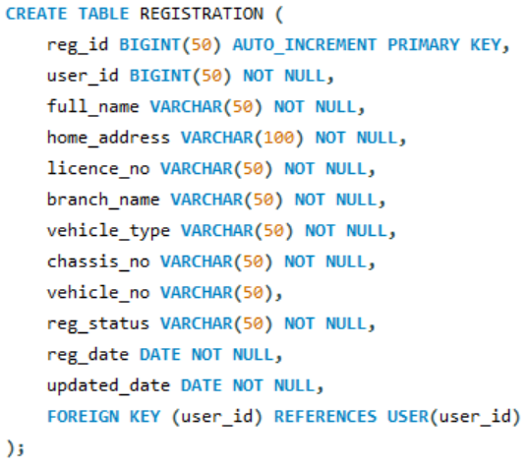
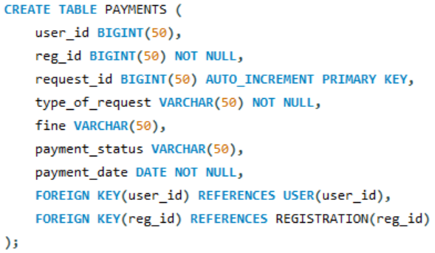
Holds the data of all the registered vehicles.
Every registration id is unique for easy search.
Necessary information about the person and vehicle is stored.
Registration status can be dismissed, deleted, approved or pending.
Registration date is stored for statistics.
Holds the data about the payments made physically.
There are 3 criteria for payments – adding back deleted, dismissed vehicle and for new sticker.
Payment status gets updated to ‘paid’ once done physically.
Payment date for statistics.

Slide 9
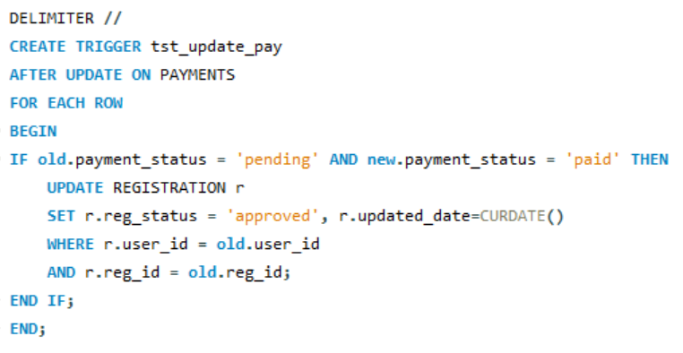
tst_update_pay trigger was created.
Once the payment_status is changed from ‘pending’ to ‘paid’.
The registration status gets updated to ‘approved’ in the registration table.
The updated date will be set you current date.

Slide 10
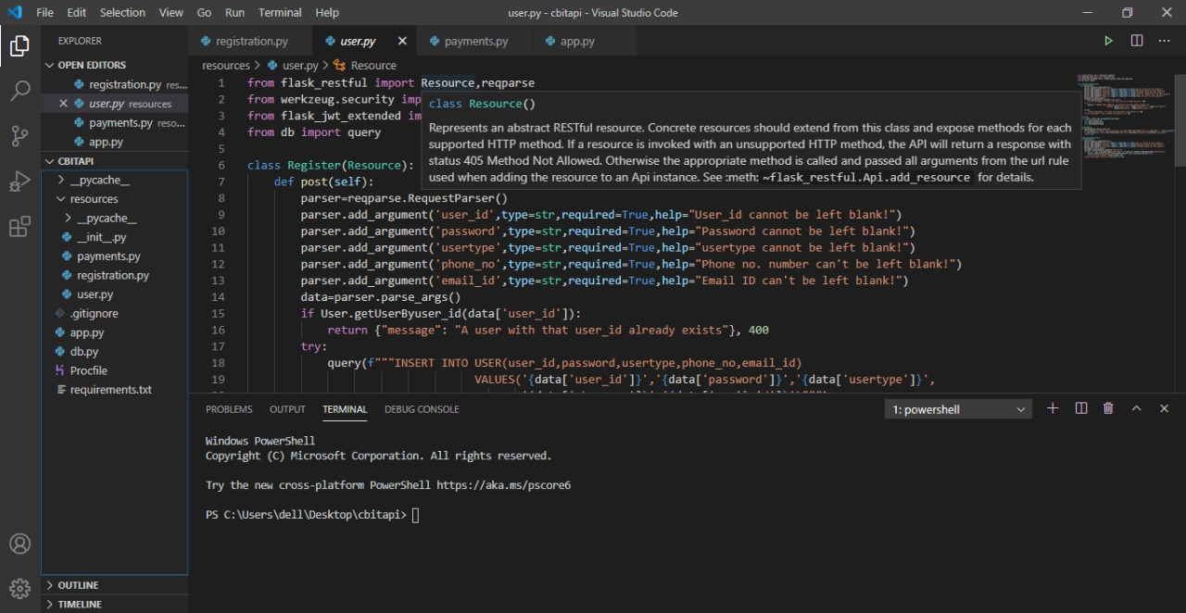
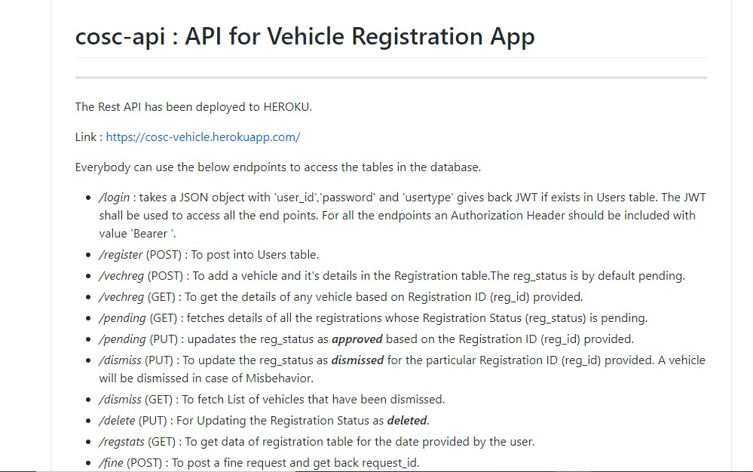
API
The Rest-API's are developed as a means of communication between the database and the mobile & web application.
Python And Flask are used to develop the API’s.
The Postman tool is used to test the API's in the local server.
The App has been deployed in heroku.

Slide 11
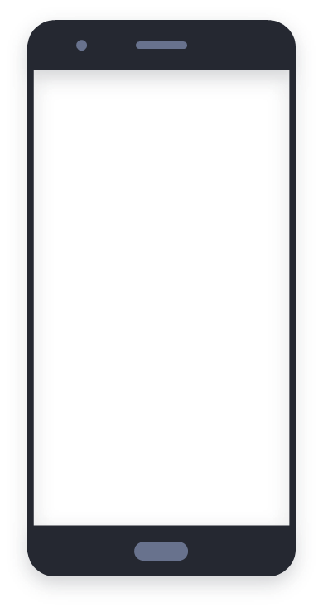
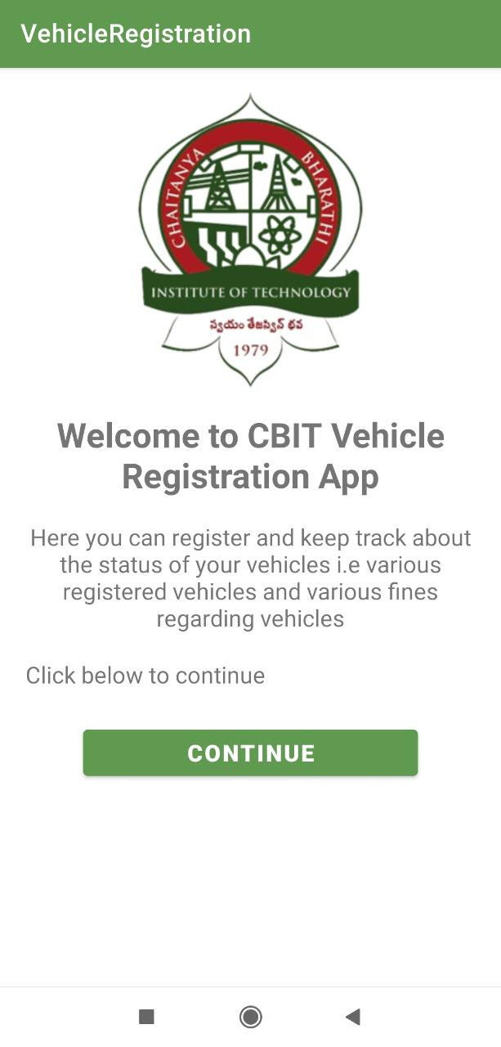
APP DEVELOPMENT (USER)
The mobile application was developed in java with the help of Android Studio.
API calls were made using the Http requests and response module.
Json parsing is used for data transfer in the request and response modules.

Slide 12
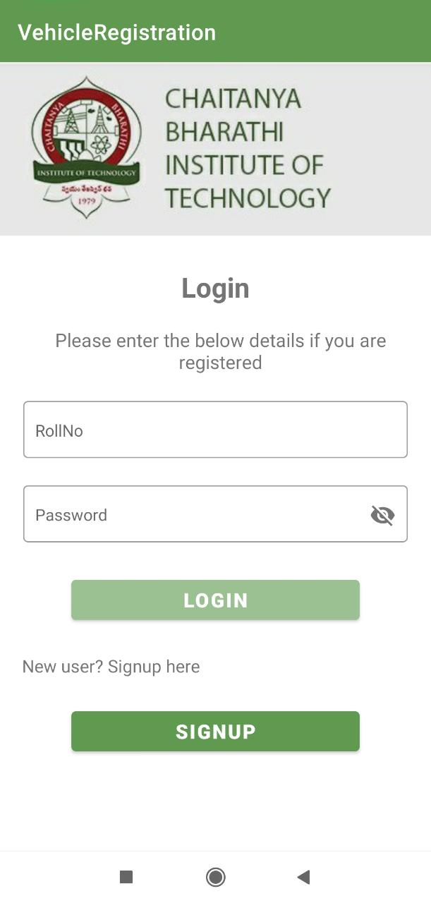
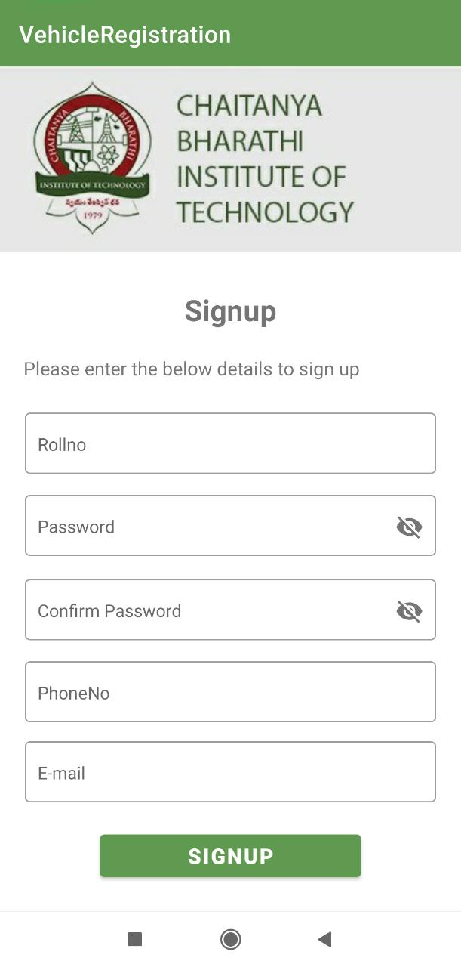
APP DEVELOPMENT (USER)
Login :
The login page has two fields, user roll number and password.
If the user enters the wrong details, toast message “Please check your details” will be displayed.
If the correct details are entered, User is redirected to the home page.
Sign-up :
The signup page has 5 fields. POST API is used to insert these details to the database.
On Successful registration, user is redirected to login page.
If user roll number already exists it shows toast message “User already exists”.

Slide 13
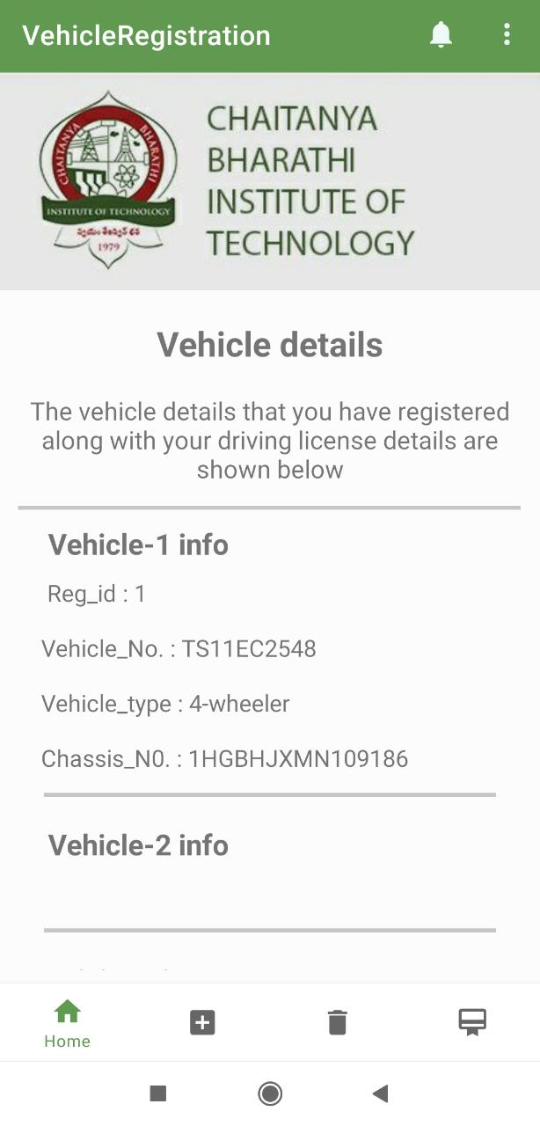
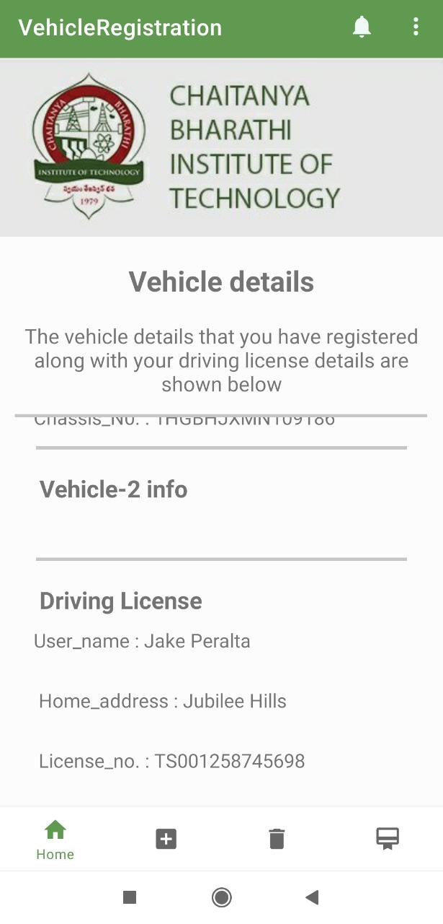
APP DEVELOPMENT (USER)
Bottom Navigation Bar:
We categorized the application features into four menu options home, add vehicle, delete vehicle, apply parking sticker.
Home :
In the home page, registered vehicle details of the user along with his driving license details will be shown.
A user can have maximum of two vehicles under his registration.
These details are displayed through the GET API call.
It shows No vehicle registered if the user did not register any of his vehicles.

Slide 14
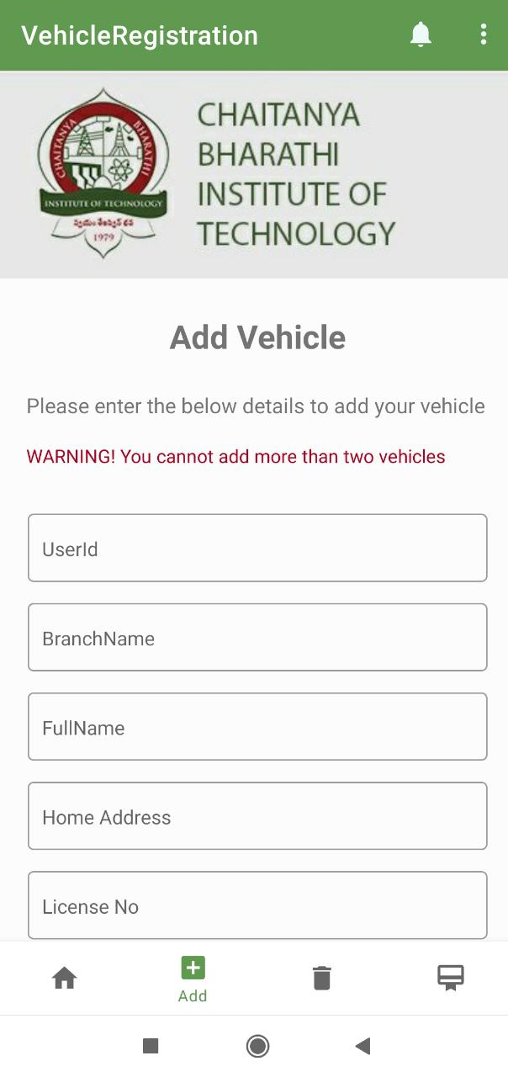
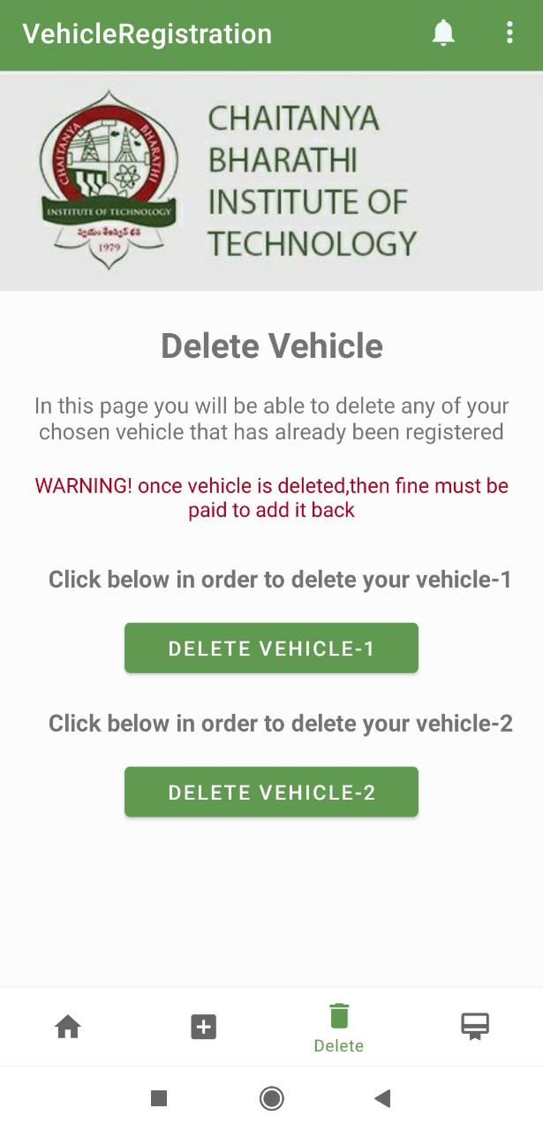
APP DEVELOPMENT (USER)
Add Vehicle :
The user can add his vehicle by providing details like roll no, full name, branch name, address, license no, vehicle no, vehicle type, chassis number and registration date.
If user tries to add vehicle which is previously deleted, a toast message will be displayed saying that vehicle is previously deleted.
This adding vehicle details into the database is done through the POST API call.
Delete Vehicle :
A button will be displayed corresponding to each vehicle, user can select which vehicle is to be deleted.
This is done through PUT API call which updates the status of vehicle as deleted.

Slide 15
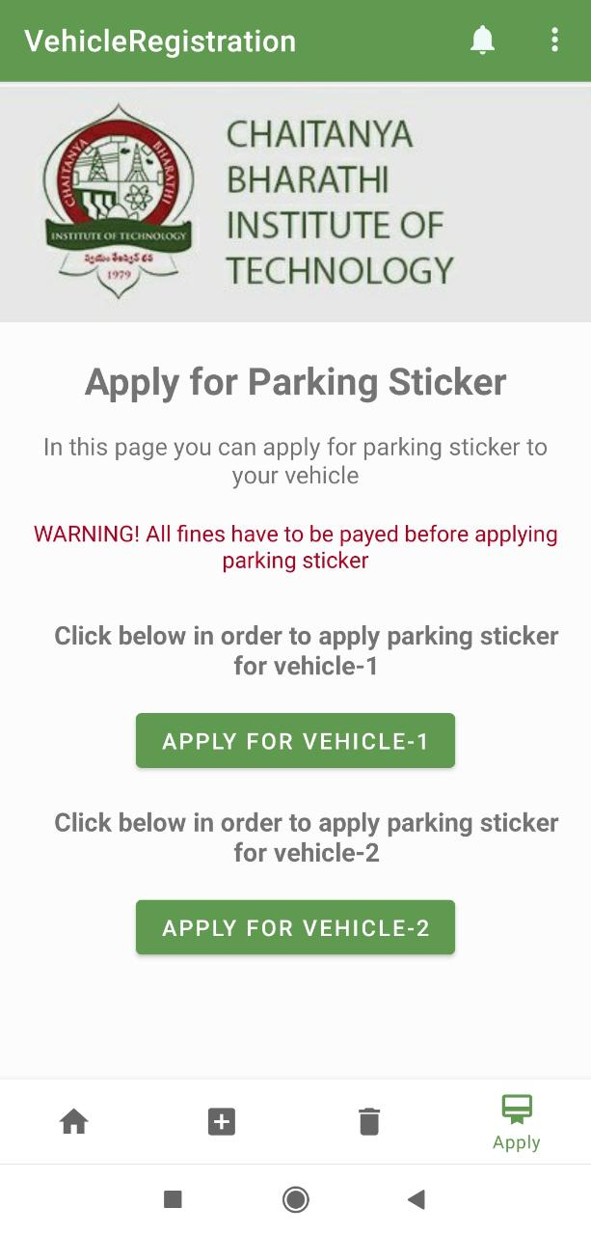
APP DEVELOPMENT (USER)
Apply Parking Sticker :
In this user has an option to apply for a new parking sticker for any of his registered vehicles.
To apply for a new parking sticker, user must pay a fine of 200 rupees.
When user applies for the sticker a unique request id is generated and is shown to the user.
The fine must be physically paid by the user, on payment of the fine admin issues the new parking sticker.
This is done through POST API call.

Slide 16
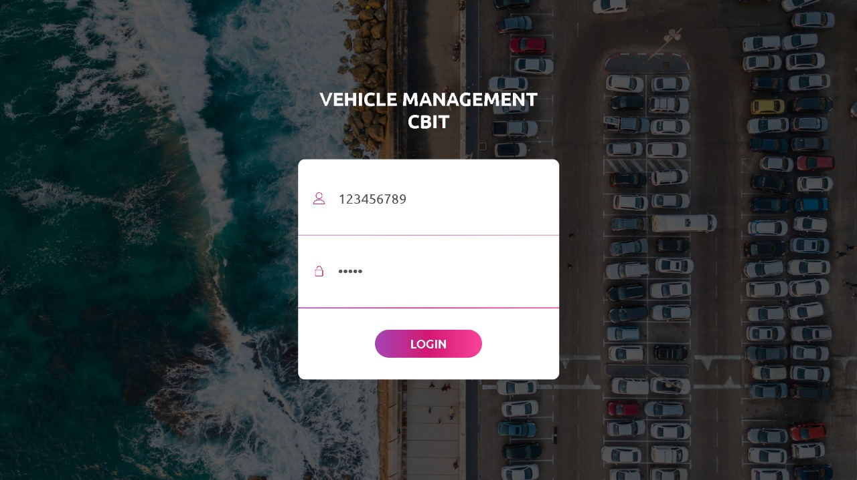
WEB DEVELOPMENT (ADMIN)
Login Page
There is no signup for the admin.
We give the Default Admin-ID and Password that is already stored in the database for the Admin.
Admin can login with the credentials given.
Once the credentials are verified, the admin will be redirected to the dashboard.

Slide 17
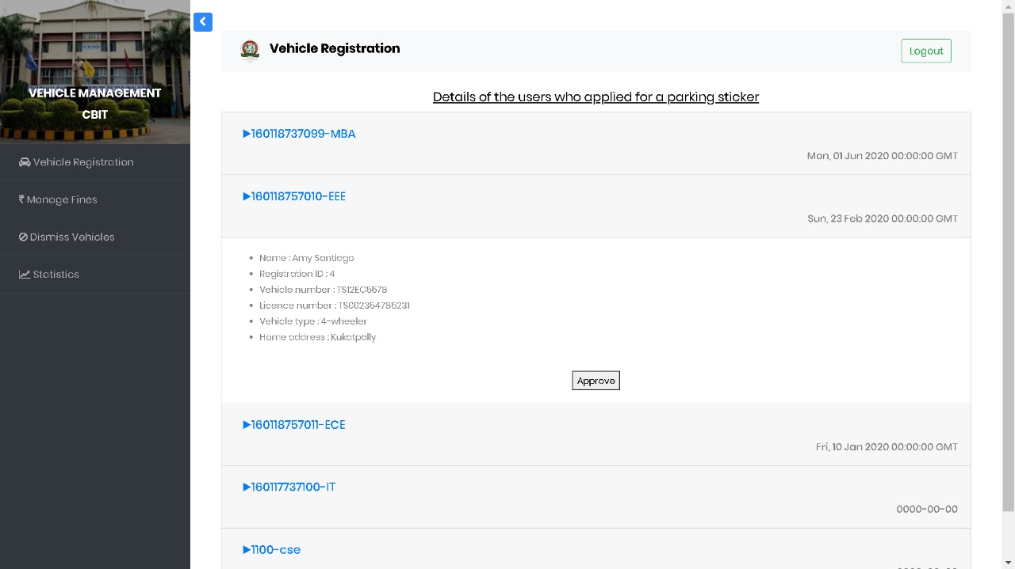
WEB DEVELOPMENT (ADMIN)
Manage Registrations Page
Consists of a dashboard where the user IDs and branches of the pending vehicle applications are displayed.
On clicking the card, all details regarding the vehicle and license of the vehicle owner will be displayed.
On clicking the approve button, a confirmation alert will pop up and if accepted the vehicle status will be updated to approved.

Slide 18
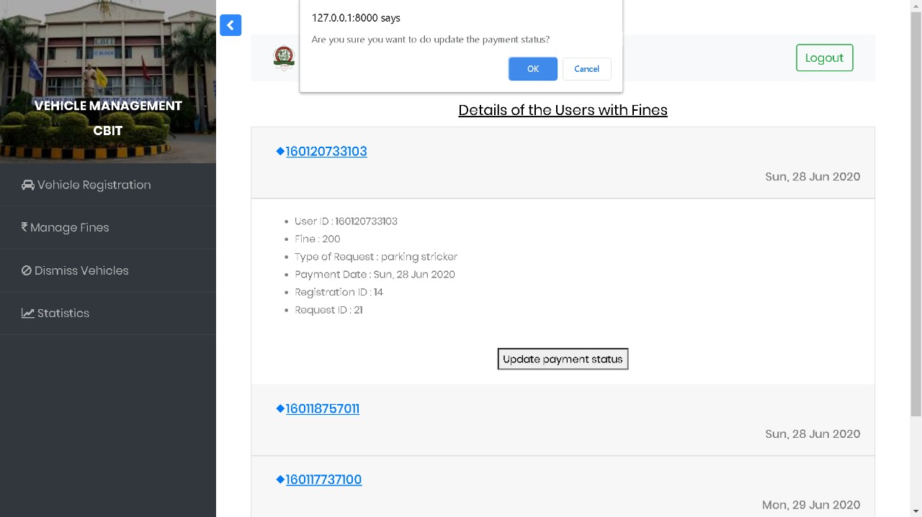
WEB DEVELOPMENT (ADMIN)
Manage Fines Page
It consists of a Dashboard where the UserID along with the date of the pending payments are displayed.
On clicking the card, all the details regarding the user and fine will be displayed.
After paying fine physically, the admin can update the status of payment to ‘paid’ based on the req_id.

Slide 19
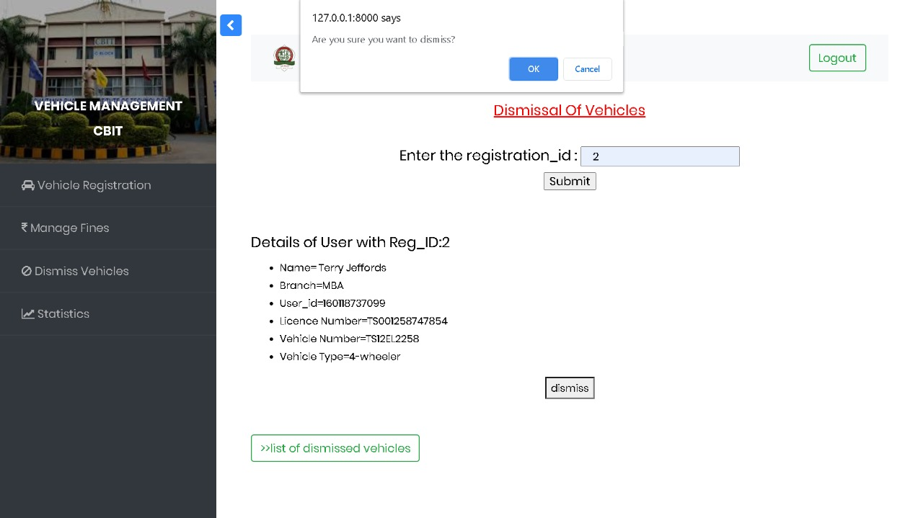
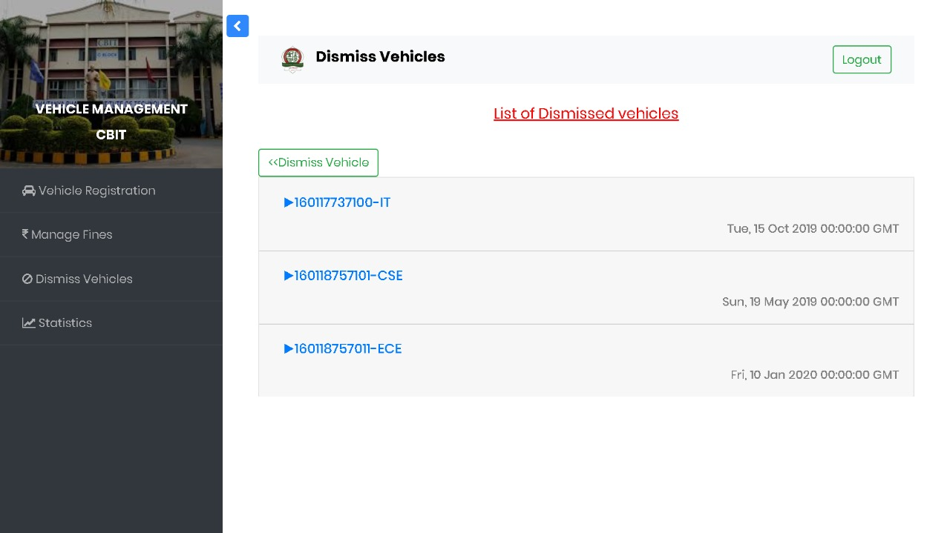
WEB DEVELOPMENT (ADMIN)
Manage Dismiss Page
As the registration id is entered by the admin all the details will be displayed along with the dismiss button.
Admin can view those details and can dismiss the vehicle.
The registration status will be updated to dismissed.
The admin can also view the ‘list of dismissed vehicles’ along with their registration details.

Slide 20
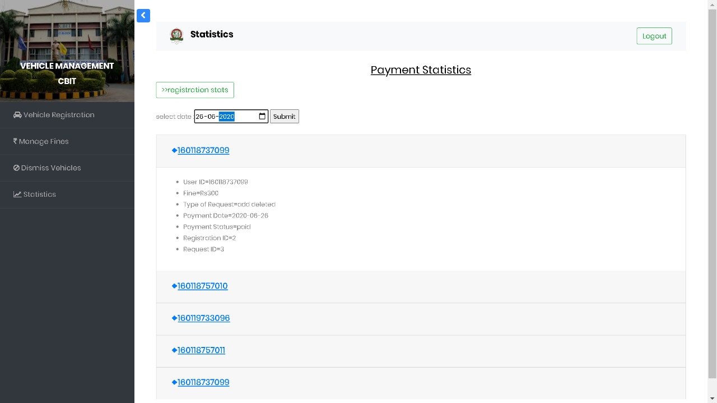
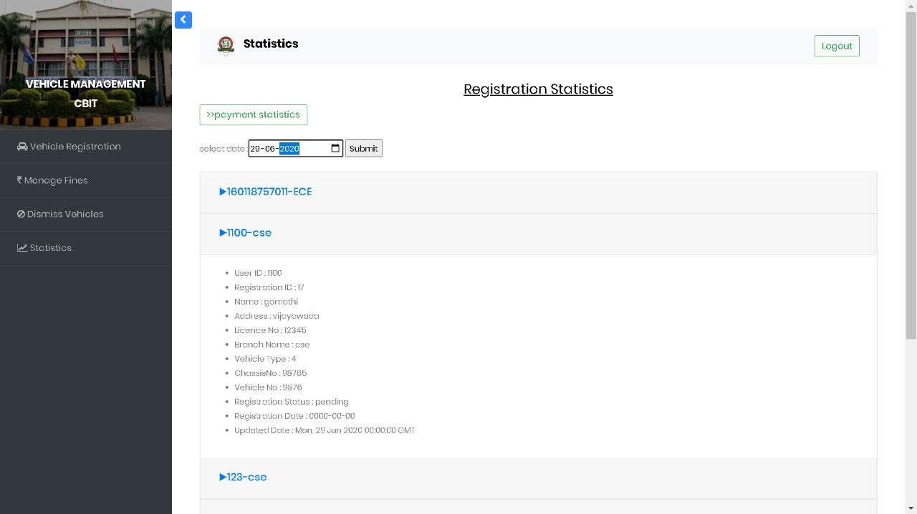
WEB DEVELOPMENT (ADMIN)
Statistics Page
This statistics page works on the date filtration.
Once the date is entered, all the registrations/payments done on that specific date will appear.
On clicking the card, all the information about the registration will be displayed.
Type of payment request is also displayed.

Slide 21
THANKS!
Any questions?

Slide 22
CREDITS
Special thanks to our project mentor Mr. Preethivardhan Anusri for his extreme support and complete guidance throughout the program.

